Slide 1

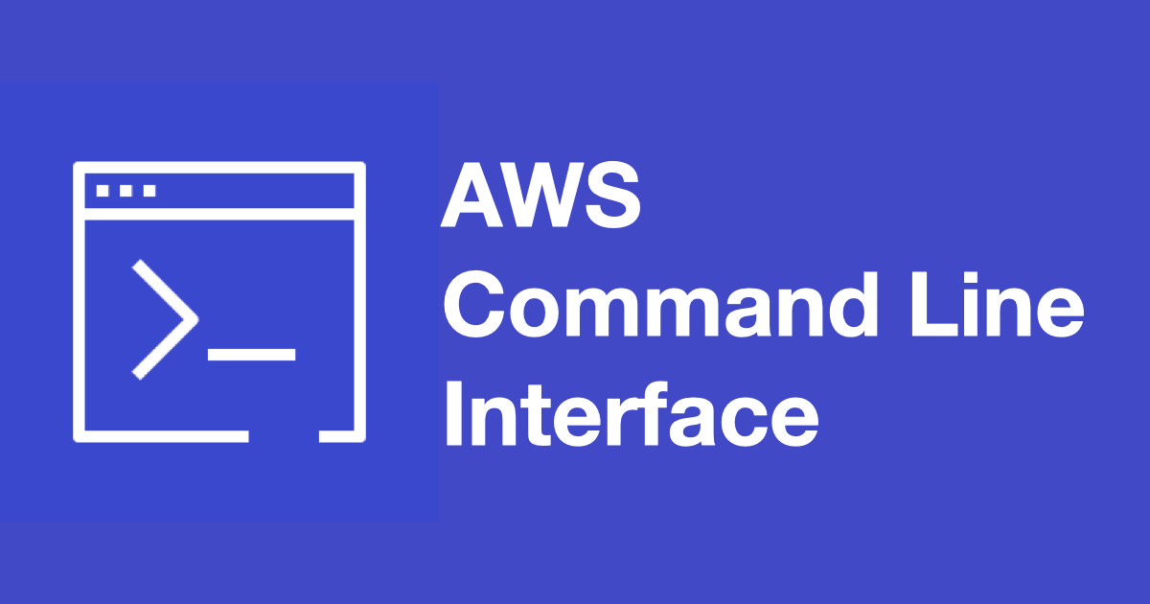

Slide 2
What is AWS CLI?
AWS Command Line Interface (CLI) is a powerful tool that enables users to interact with AWS services using a command-line shell.
It provides a uniform way to manage various AWS services, offering greater control and flexibility over the AWS environment.
With AWS CLI, users can perform almost all tasks available in the AWS Management Console, but with the added benefits of automation, scripting, and quicker execution of repetitive tasks.

Slide 3
Benefits of Using AWS CLI
Efficiency:
AWS CLI allows for the rapid execution of tasks by using commands rather than navigating through the web interface. This leads to faster setup and management of AWS resources.
Automation:
AWS CLI is essential for automating complex workflows. By scripting AWS CLI commands, users can automate routine tasks such as creating and terminating instances, managing S3 buckets, and deploying applications.

Slide 4
Scalability:
AWS CLI is designed to handle large-scale operations. Whether managing a single resource or hundreds, CLI commands can easily scale to meet the demands of large environments.
Flexibility:
With AWS CLI, users can combine multiple commands in scripts to perform intricate operations. This flexibility is particularly useful for DevOps practices, continuous integration, and deployment pipelines.
Consistency Across Platforms:
AWS CLI provides a consistent experience across different operating systems, including Windows, macOS, and Linux, allowing users to manage their AWS resources from any platform.

Slide 5
Key Features of AWS CLI
Unified Tool:
AWS CLI is a single tool that supports a wide range of AWS services, including EC2, S3, RDS, Lambda, IAM, and more. This unification simplifies the management of diverse AWS services from a single interface.
Scripting and Automation:
The CLI can be used to write scripts that automate the management of AWS services. These scripts can be integrated into CI/CD pipelines, making AWS CLI a critical tool in DevOps.

Slide 6
Customizable Profiles:
AWS CLI allows users to create multiple profiles, each with different configurations, credentials, and regions. This feature is useful for managing resources across different AWS accounts or environments (e.g., development, testing, production).
Output Formatting:
Users can choose different output formats (JSON, text, or table) depending on their needs. This flexibility helps in parsing output data for further processing or integrating with other tools.
Access to AWS Features:
AWS CLI provides access to the latest AWS features and services as they are released, often before they are available in the AWS Management Console.

Slide 7
Security Considerations
Credential Management
Least Privilege Principle
Multi-Factor Authentication (MFA)
Encryption of Data

Slide 8
Why Learn AWS CLI?
Mastering AWS CLI is essential for developers, system administrators, and DevOps professionals who seek greater control, efficiency, and flexibility in managing AWS services. It is a powerful tool that complements the AWS Management Console, enabling the automation of tasks, scaling operations, and improving security practices in cloud environments.

